Slide 1
LFL Classical ML Notification System
10.04.2026

Slide 2
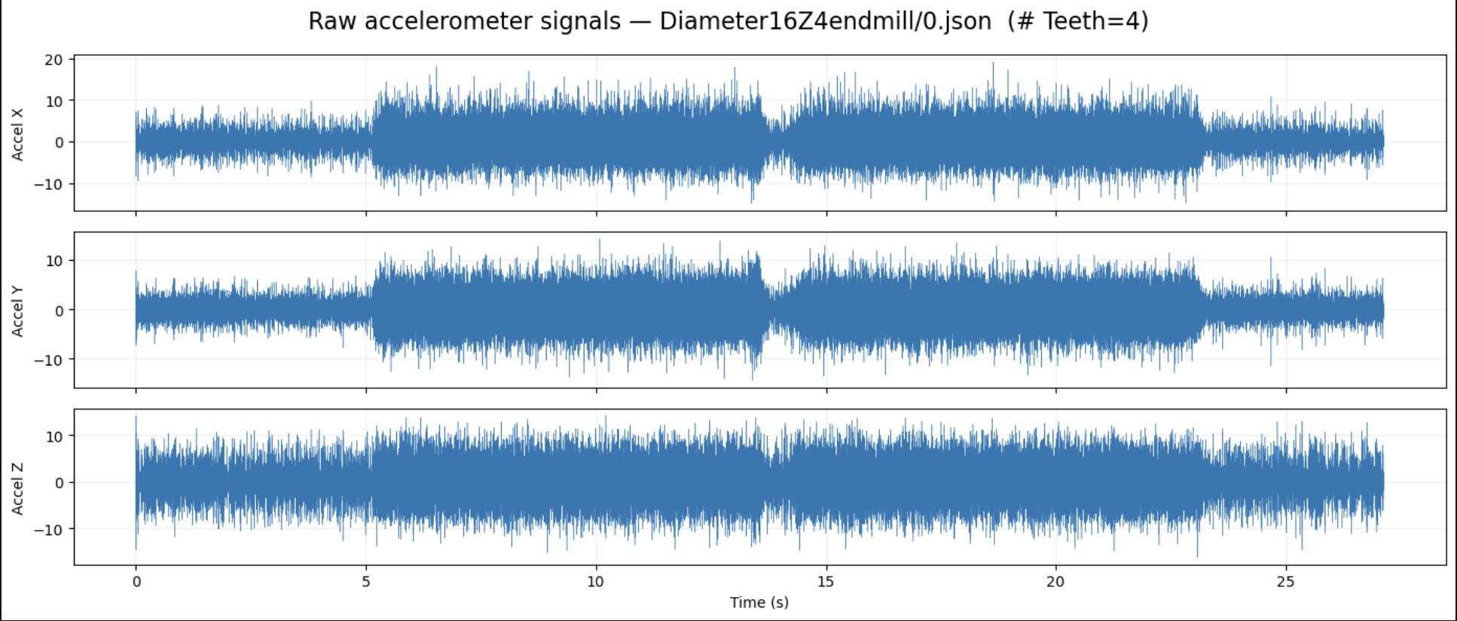
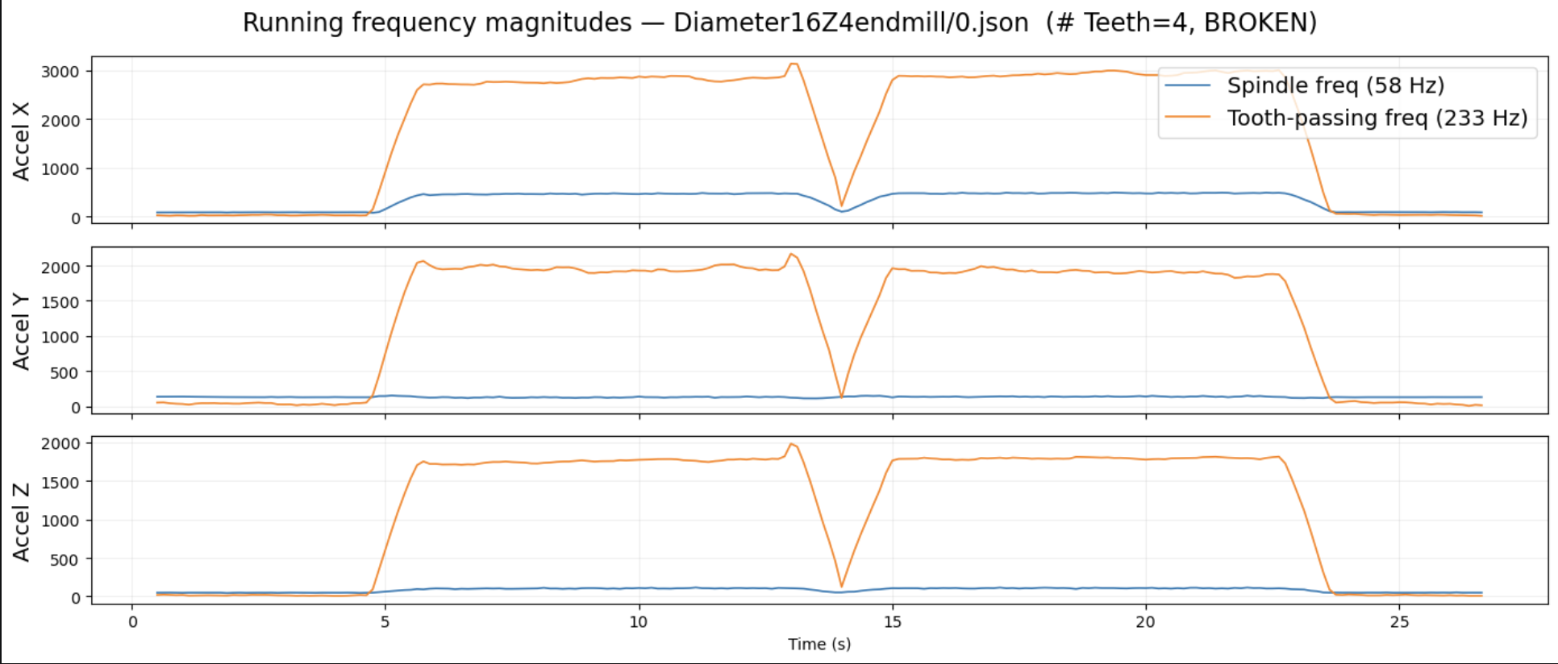
Assumptions and design
1. Frequency data collected every second across 3 directions
2. We know whether a process has resulted in a break or not
3. We want a lightweight and interpretable model that incorporates domain-knowledge

Slide 3
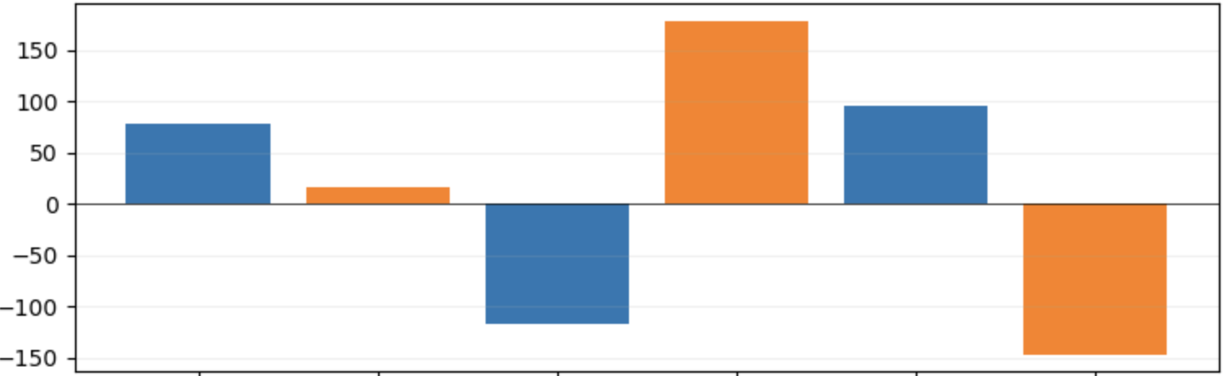
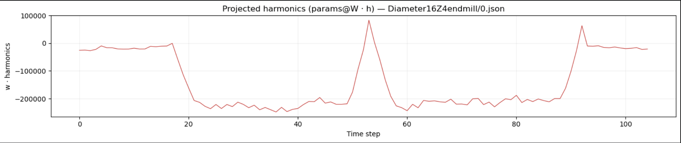
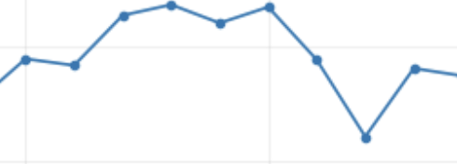
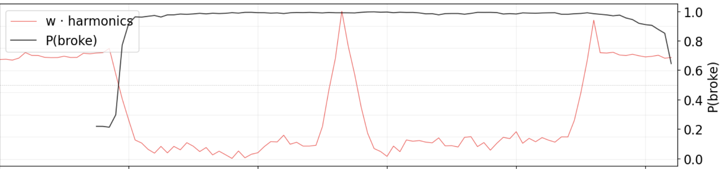
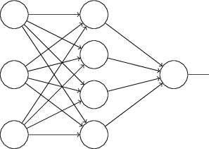


Pipeline
1. Generate Interpretable Combination in Real Time (Simple Vector Dot Product)
$$∗$$
Weights on each Freq.
(Based on Operational Settings)
(Interpretable) Frequency Combination Timeseries
Incoming Frequency Data
2. Pass Sliding Window to Small CNN
Break Prob
Use most recent n timepoints
Small CNN ($\sim 5000$ params)
New break prediction

Slide 4
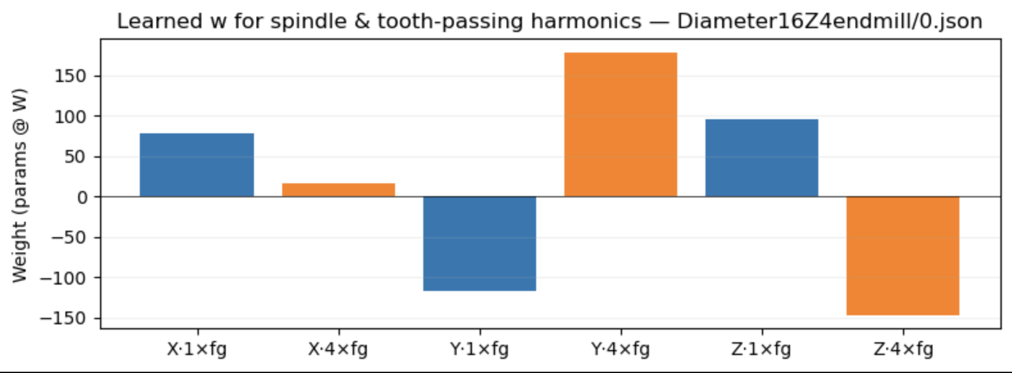
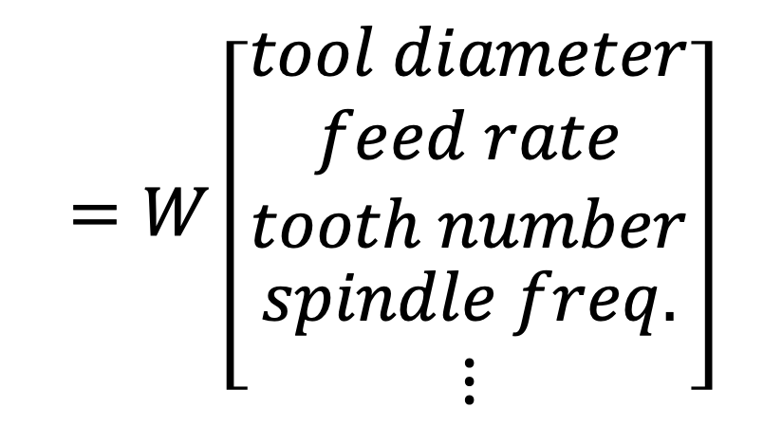
Where is the Interpretability
$$=W\left[\begin{matrix}\begin{matrix}tool diameter \\ feed rate \\ tooth number\end{matrix} \\ spindle freq. \\ ⋮\end{matrix}\right]$$
The harmonic weights tell us what harmonics are important under what operational settings
Learned weight matrix

